Slide 1

SNAKE Nguyễn Quang Minh

Slide 2
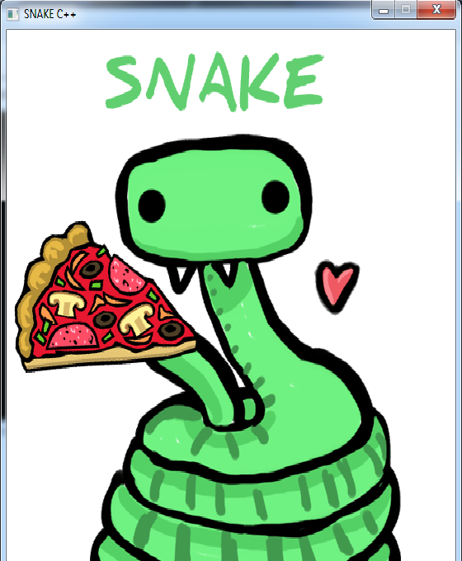

Functions and details
- Project name: Snake
- Idea : Available and famous game
- Functional requirements :
+ Theme music
+ Gameplay music
+ Intro
+ Main menu
+ Game over menu
+ Replay/retry
+ Restart

Slide 3
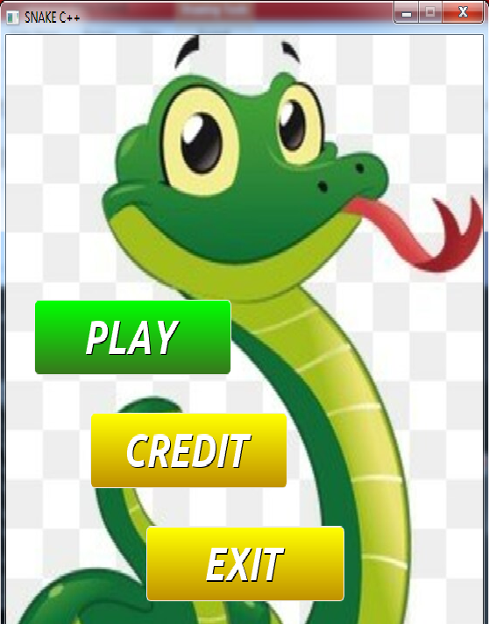
Main Menu
Functions :
Play
Credit
Exit
Mouse Event

Slide 4
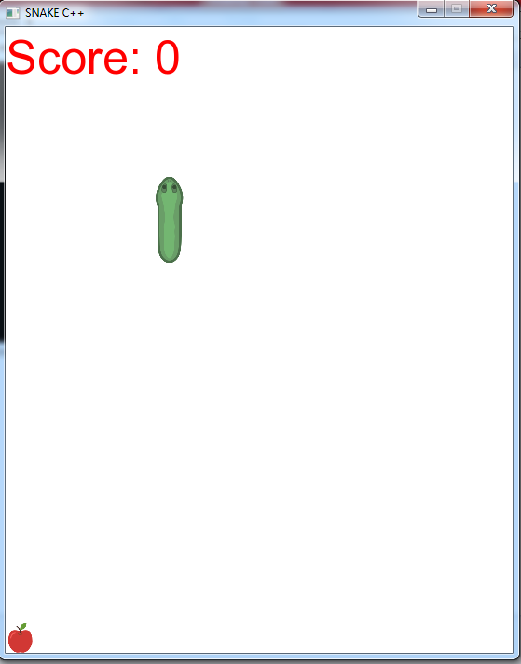
Gameplay
Functions :
Score
Random apple
Limited map
Animation

Slide 5
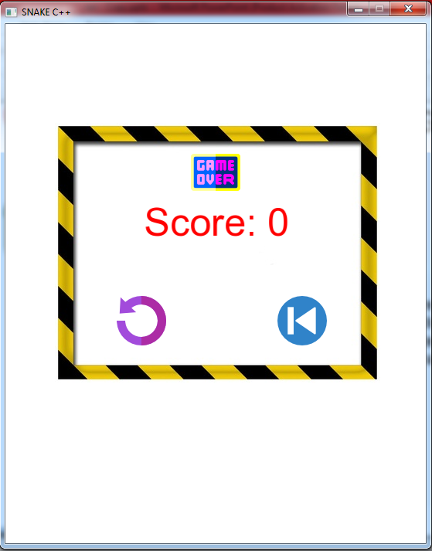
Gameplay
Functions :
Score reapprear
Replay
Restart

Slide 6

Thank you everyone for watching !

